Slide 1
3D Image Segmentation and Quantification of Lysosomes
Comparison manual.VS. automatic
4/12/2025

Slide 2
LAST MEETING
My progress these last few weeks:
Checked the size.
Included additional metrics such as mean and standard deviation.
Comparison MANUAL.vs.AUTOMATIC.
Now the script can assign serial order numbers to lysosome and cell IDs.
Review possible over-detection in some images.
I am working in the automatization of same parameters to avoid or reduce over deteccion on all images.
Verify cases where there are lysosomes outside with a different cell ID.
I will start working on this point next week.
OREN: One addition/clarification - need to find a way to limit cell size to a certain (lower) limit so to exclude these fragments being counted as a cell…

Slide 3
FILES
40A_UAS-TMEM1923x-HA x 71G10 40A MARCM_L3_1_Airy_010724
Airy scan_40A_UAS-TMEM-HA_CB_0h_1_051222
Airy scan_40A_UAS-TMEM-HA_CB_0h_2_051222
Airy scan_40A_UAS-TMEM-HA_CB_4h_1_051222
Airy scan_40A_UAS-TMEM-HA_CB_4h_2_051222
AiryScan-UAS-GFP cyto_40A_UAS-TMEM-3xHA_CB_6h_2_300423.tif
TMEM-HA 6h CB airy_3_170722
40A_UAS-TMEM192-3xHA x 40A 71G10 MARCM_around 12h - for quantification_4 Airy-CBs_300425
40A_UAS-TMEM192-3xHA x 40A 71G10 MARCM_around 12h - for quantification_3 Airy-CBs_300425

Slide 4
40A_UAS-TMEM1923x-HA x 71G10 40A MARCM_L3_1_Airy_010724

Slide 5
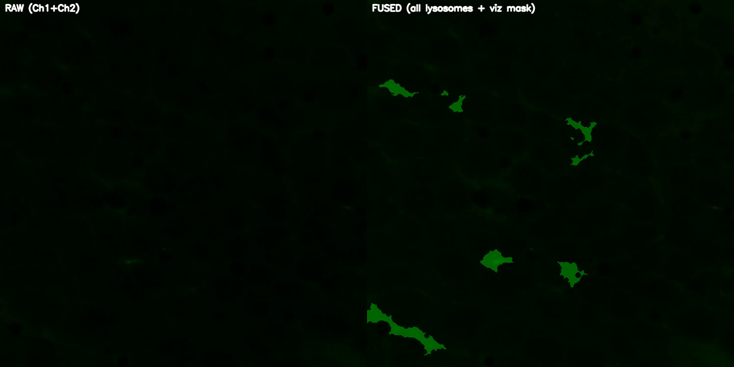
DETECTION VIDEO

Slide 6
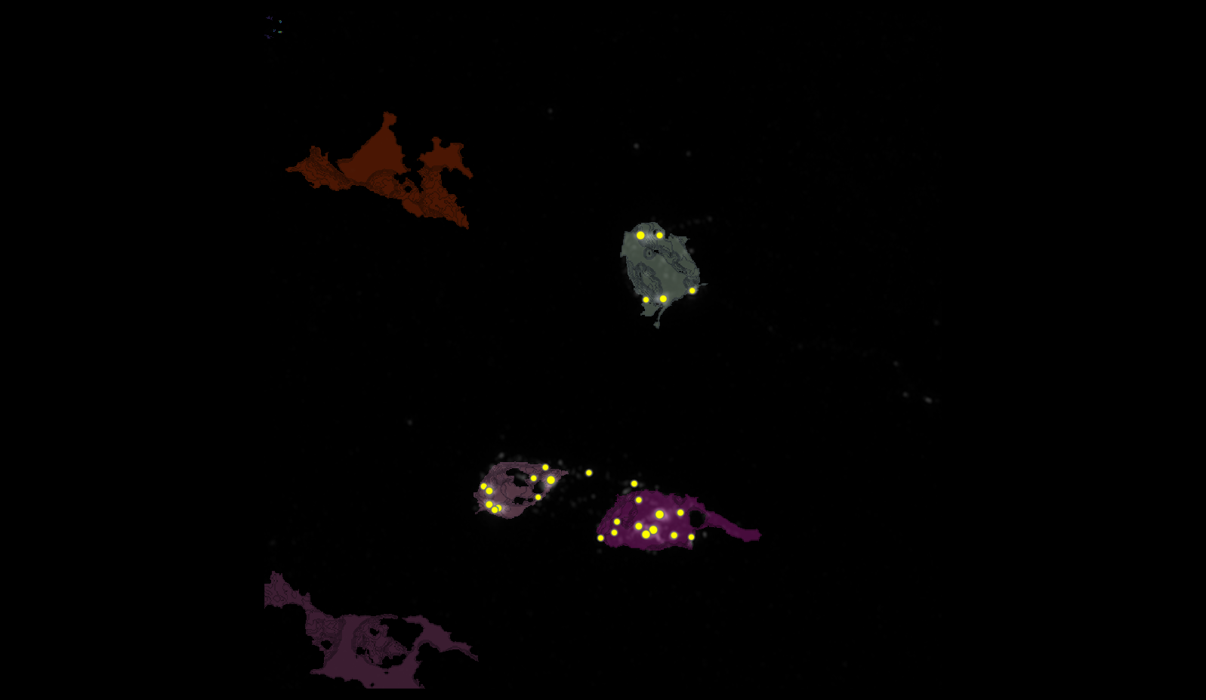
SEGMENTATION
2
3
4

Slide 7
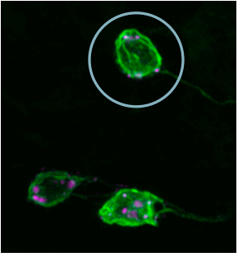
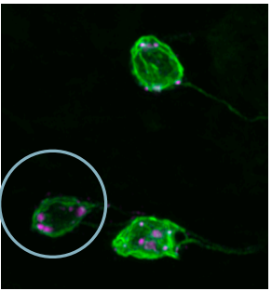
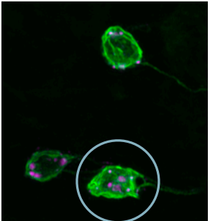
MANUAL.vs.AUTOMATIC
2
3
4

Slide 8
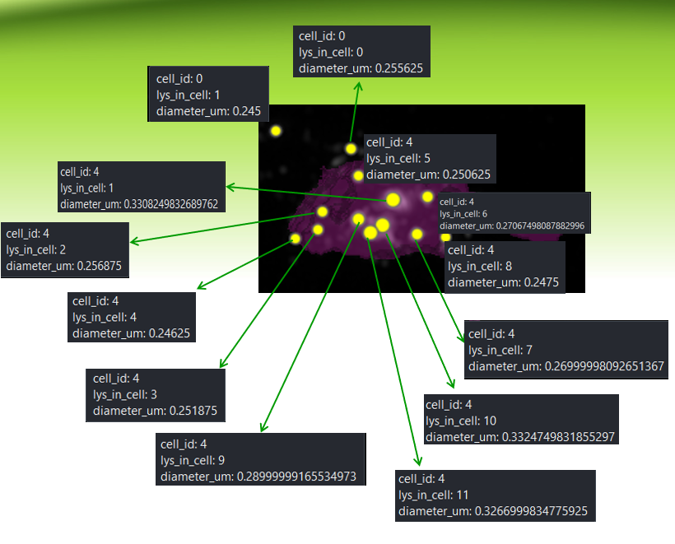
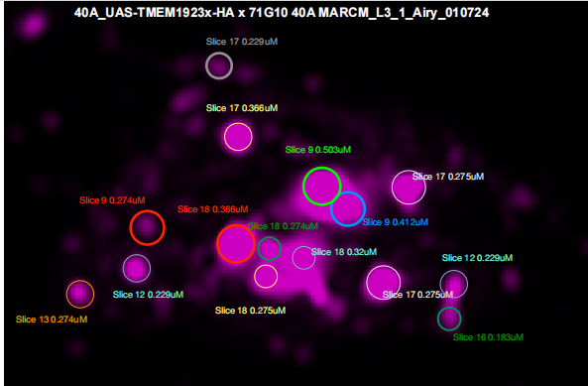
MANUAL.vs.AUTOMATIC
4
1
0
6
5
1
2
4
9
10
8
3
7
11
OUTSIDE(ID lysosomes)
INSIDE(ID lysosomes)

Slide 9
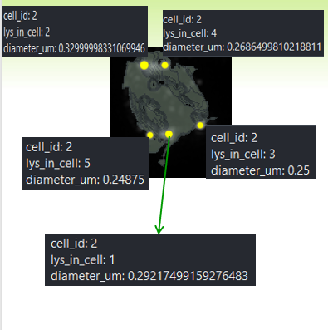
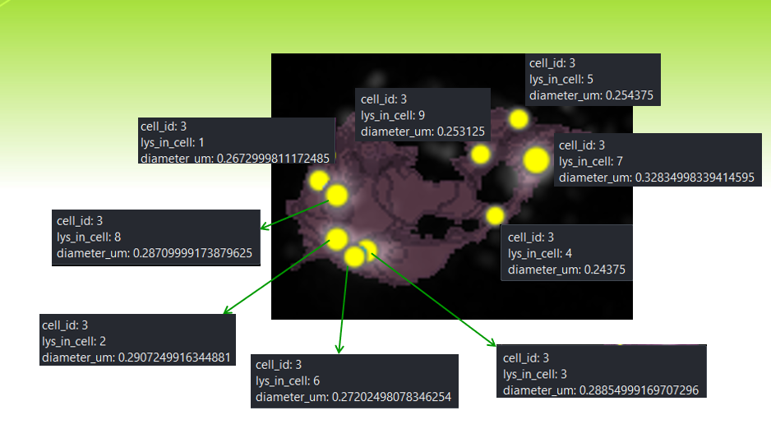
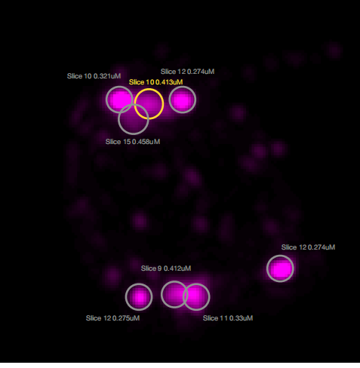
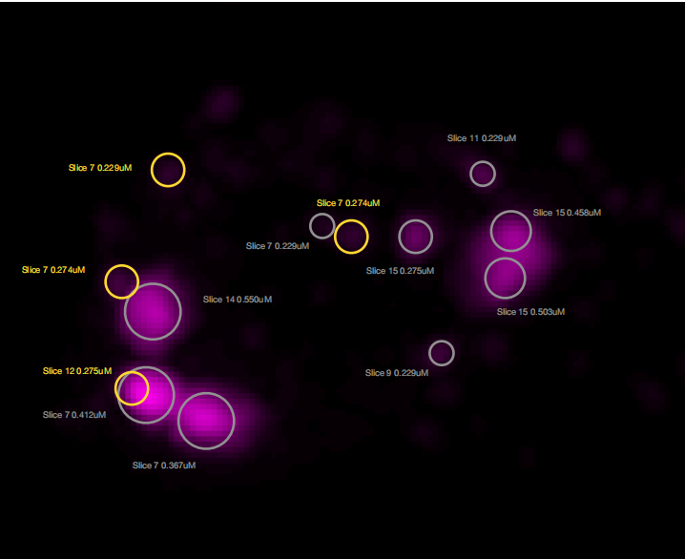
MANUAL.vs.AUTOMATIC
3
2
2
4
5
9
1
7
2
8
3
4
5
6
3
1

Slide 10
MANUAL.vs.AUTOMATIC
ID CELL | ID LY | MANUAL | AUT
0 | 0 | 0.229 | 0.256
0 | 1 | NOT DATA | 0.245
4 | 1 | 0.503/0.412 | 0.331
4 | 2 | 0.274 | 0.257
4 | 3 | 0.229 | 0.252
4 | 4 | 0.274 | 0.246
4 | 5 | 0.366 | 0.251
4 | 6 | 0.275 | 0.271
4 | 7 | 0.275 | 0.270
4 | 8 | 0.229/0.183 | 0.248
4 | 9 | 0.366 | 0.290
4 | 10 | 0.32 | 0.332
4 | 11 | 0.275/0.274 | 0.327
ID CELL | ID LY | MANUAL | AUT
3 | 1 | 0.270 | 0.267
3 | 2 | 0.270 | 0.291
3 | 3 | 0.367 | 0.289
3 | 4 | 0.244 | 0.229
3 | 5 | 0.254 | 0.229
3 | 6 | 0.412 | 0.291
3 | 7 | 0.458/0.503 | 0.328
3 | 8 | 0.550 | 0.288
3 | 9 | 0.275 | 0.253
2 | 1 | 0.412/0.33 | 0.292
2 | 2 | 0.321 | 0.33
2 | 3 | 0.274 | 0.25
2 | 4 | 0.274 | 0.269
2 | 5 | 0.275 | 0.249

Slide 11
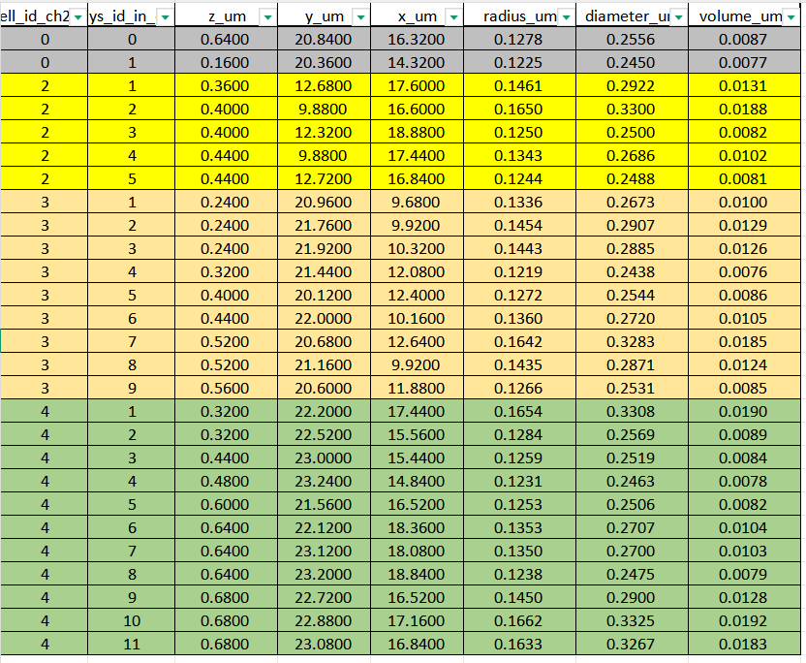
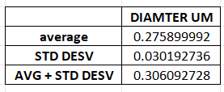
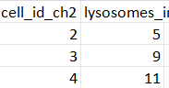
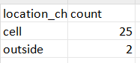
DATASET LYSOSOMES(ORDER FOR CELL ID)

Slide 12
Airy scan_40A_UAS-TMEM-HA_CB_0h_1_051222

Slide 13
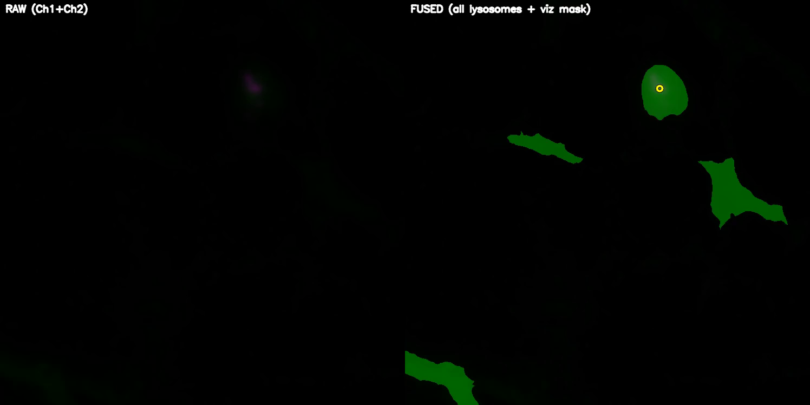
DETECTION VIDEO

Slide 14
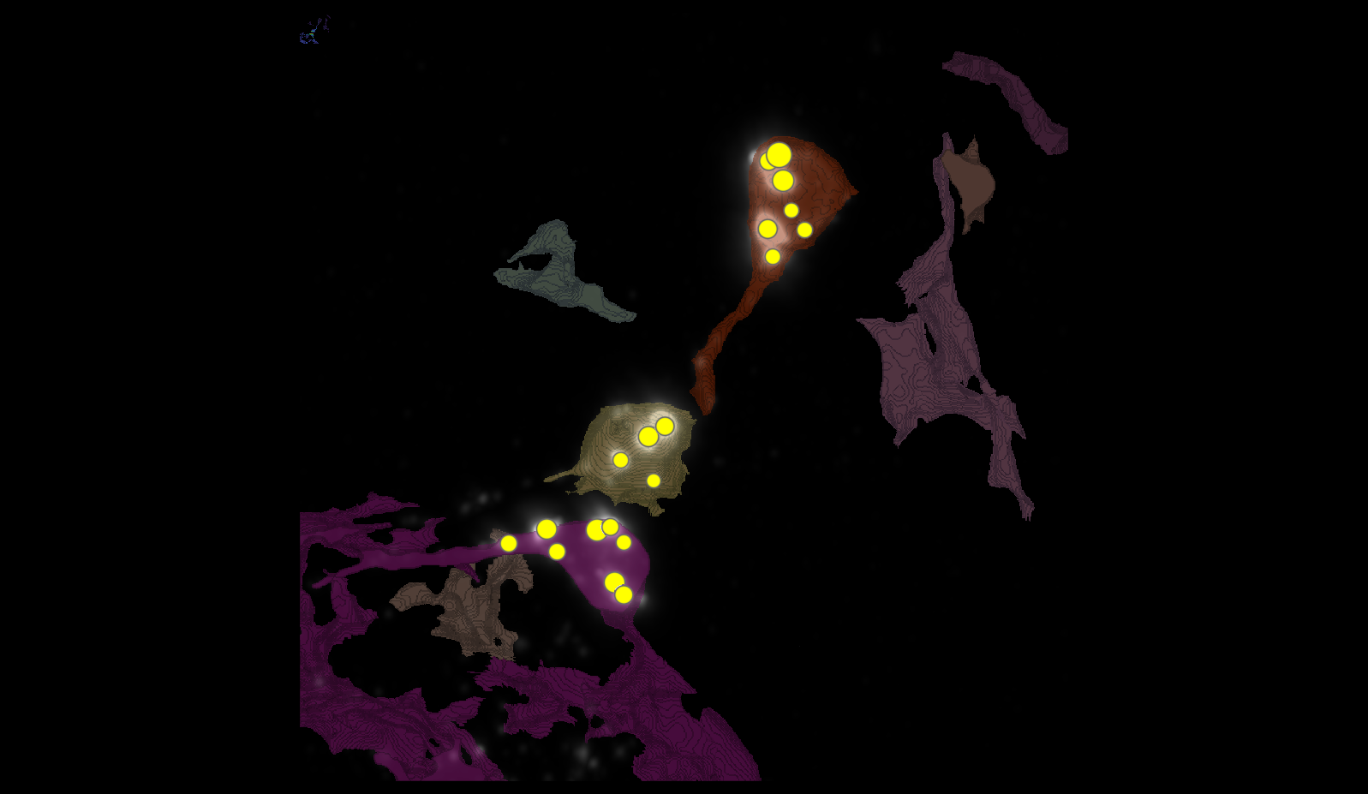
SEGMENTATION

Slide 15
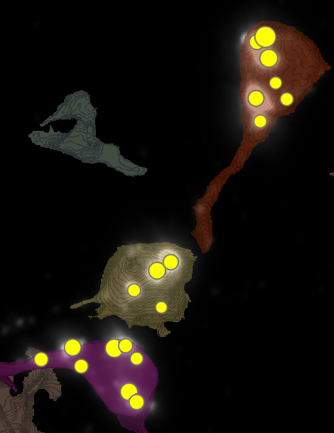
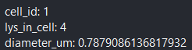
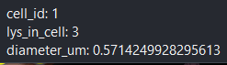
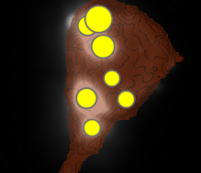
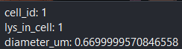
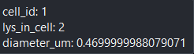
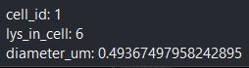
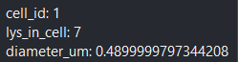
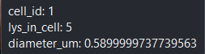
METRICS
1
6
4

Slide 16
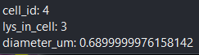
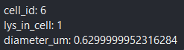
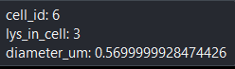
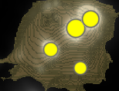
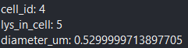
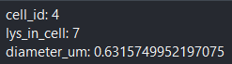
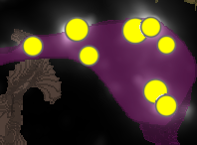
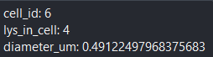
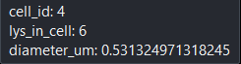
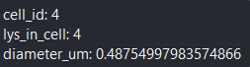
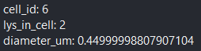
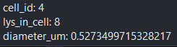
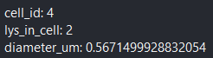
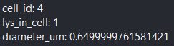
METRICS

Slide 17
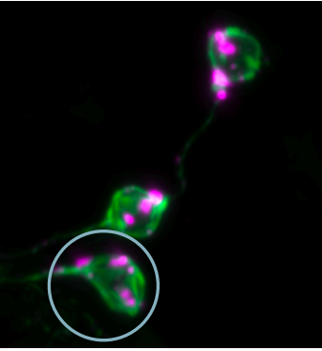
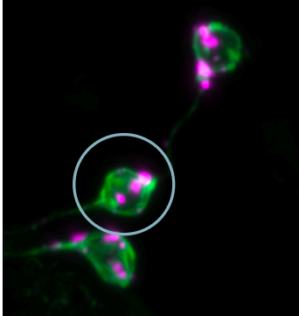
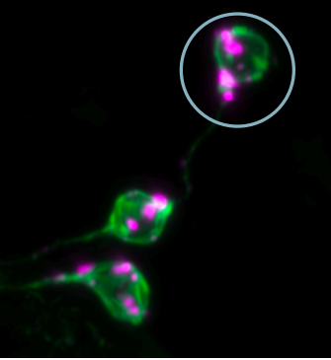
MANUAL.vs.AUTOMATIC
4
6
1

Slide 18
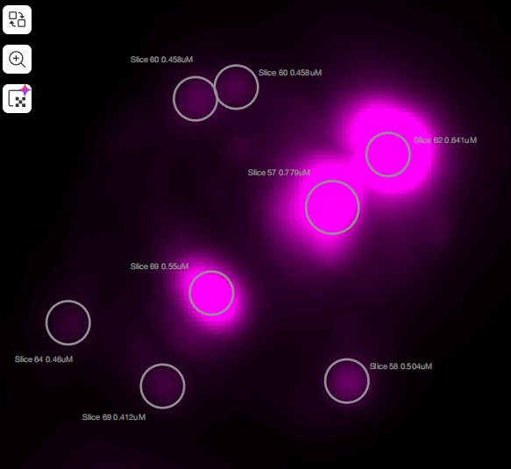
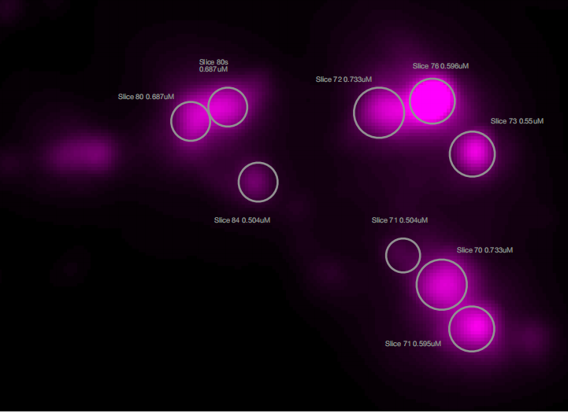
MANUAL.vs.AUTOMATIC
3
7
3
5
1
4
8
4
2
1
2

Slide 19
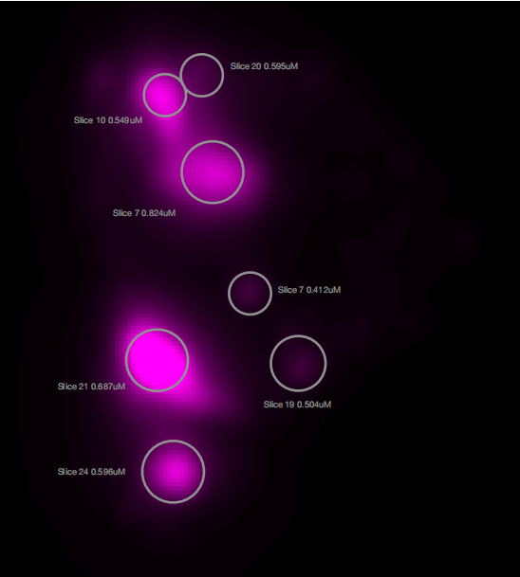
MANUAL.vs.AUTOMATIC
4
3
1
2
5
6
7

Slide 20
MANUAL.vs.AUTOMATIC
ID CELL | ID LY | MANUAL | AUT
1 | 1 | 0.824 | 0.670
1 | 2 | 0.412 | 0.470
1 | 3 | 0.549 | 0.571
1 | 4 | 0.595 | 0.788
1 | 5 | 0.687 | 0.590
1 | 6 | 0.504 | 0.493
1 | 7 | 0.596 | 0.490
4 | 1 | 0.733 | 0.650
4 | 2 | 0.595 | 0.567
4 | 3 | 0.733 | 0.690
4 | 4 | 0.550 | 0.488
4 | 5 | 0.596 | 0.530
4 | 6 | NOT DATA | 0.531
4 | 7 | 0.687/0.687 | 0.632
4 | 8 | 0.504 | 0.527
ID CELL | ID LY | MANUAL | AUT
6 | 1 | 0.779 | 0.630
6 | 2 | 0.504 | 0.450
6 | 3 | 0.641 | 0.570
6 | 4 | 0.550 | 0.491

Slide 21
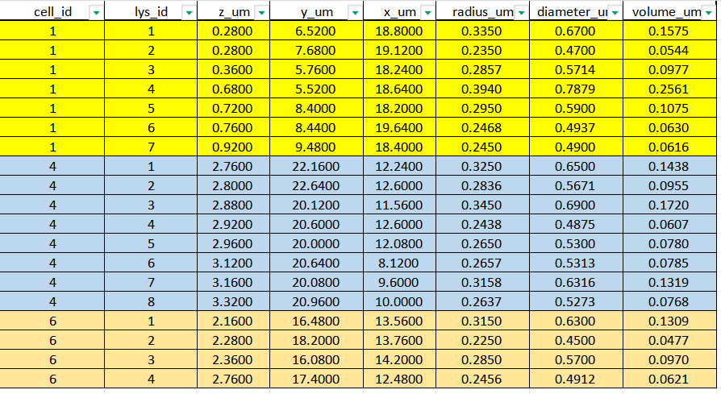
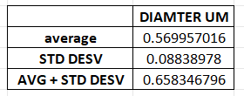
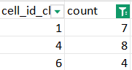
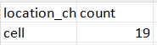
DATASETS

Slide 22
Airy scan_40A_UAS-TMEM-HA_CB_0h_2_051222

Slide 23

DETECTION VIDEO

Slide 24

SEGMENTATION
1
4
2
3

Slide 25


















MANUAL.vs.AUTOMATIC
1
4
2
2
1
3
5
5
4
3
1
6
4
6

Slide 26
MANUAL.vs.AUTOMATIC
ID CELL | ID LY | MANUAL | AUT
1 | 1 | 0.691 | 0.570
1 | 2 | 0.681 | 0.690
1 | 3 | 0.585 | 0.627
1 | 4 | 0.642 | 0.550
1 | 5 | 0.961 | 0.692
1 | 6 | 0.595 | 0.750
4 | 1 | 0.549 | 0.490
4 | 2 | 0.595 | 0.530
4 | 3 | 0.550 | 0.510
4 | 4 | 0.641 | 0.590
4 | 5 | 0.732 | 0.630
4 | 6 | 0.824 | 0.632

Slide 27




DATASET LYSOSOMES(ORDER FOR CELL ID)

Slide 28
Airy scan_40A_UAS-TMEM-HA_CB_4h_1_051222

Slide 29

DETECTION VIDEO

Slide 30

SEGMENTATION
4
5
2
3

Slide 31


























METRICS
4
1
2
3

Slide 32






MANUAL.vs.AUTOMATIC
6
3
8
4
4
7
5
6
5
1
2
7
1
3
2
4

Slide 33
MANUAL.vs.AUTOMATIC
ID CELL | ID LY | MANUAL | AUT
2 | 1 | NOT DATA | 0.534
2 | 3 | 0.687 | 0.632
2 | 4 | 0.641 | 0.567
2 | 5 | 0.687/0.641 | 0.627
2 | 6 | 0.733 | 0.590
2 | 7 | 0.595 | 0.690
2 | 8 | 0.778 | 0.610
4 | 1 | 0.549 | 0.550
4 | 2 | 0.641 | 0.530
4 | 3 | 0.641 | 0.571
4 | 4 | 0.595 | 0.531
4 | 5 | 0.551 | 0.564
4 | 6 | 0.96 | 0.710
4 | 7 | 0.733 | 0.630

Slide 34




DATASETS

Slide 35
Airy scan_40A_UAS-TMEM-HA_CB_4h_2_051222

Slide 36

DETECTION VIDEO

Slide 37

SEGMENTATION
2
3
6

Slide 38




























METRICS

Slide 39




MANUAL.vs.AUTOMATIC
3
2

Slide 40


MANUAL.vs.AUTOMATIC
4
6
3
4
8
3
1
11
2
7
7
12
5
6

Slide 41
MANUAL.vs.AUTOMATIC
ID CELL | ID LY | MANUAL | AUT
2 | 1 | 0.595 | NOT DATA
2 | 2 | 0.687 | 0.587
2 | 3 | 0.596 | 0.584
2 | 4 | 0.687 | 0.650
2 | 5 | 0.549 | 0.570
2 | 6 | 0.824 | 0.730
2 | 7 | 0.687 | 0.710
ID CELL | ID LY | MANUAL | AUT
3 | 1 | NOT DATA | 0.550
3 | 3 | 0.687 | 0.590
3 | 4 | 0.550 | 0.594
3 | 5 | NOT DATA | 0.750
3 | 6 | 0.549 | 0.632
3 | 7 | NOT DATA | 0.551
3 | 8 | 0.550 | 0.490
3 | 9 | NOT DATA | 0.511
3 | 10 | NOT DATA | 0.790
3 | 11 | 0.550 | 0.597
3 | 12 | 0.778 | 0.630

Slide 42




DATASETS

Slide 43
AiryScan-UAS-GFP cyto_40A_UAS-TMEM-3xHA_CB_6h_2_300423.tif

Slide 44




SEGMENTATION
3
0-1
0-3
1
2
0-0

Slide 45



MANUAL.vs.AUTOMATIC
1
2
3

Slide 46









MANUAL.vs.AUTOMATIC
5
2
4
0-1
1
3
1

Slide 47









MANUAL.vs.AUTOMATIC
2
1
7
6
2
4
5
3

Slide 48








MANUAL.vs.AUTOMATIC
3
2
1
4
3
5
0-3

Slide 49
MANUAL.vs.AUTOMATIC
ID CELL | ID LY | MANUAL | AUT
1 | 1 | 0.340 | 0.331
1 | 2 | 0.425 | 0.391
1 | 3 | 0.382/0.425 | 0.350
1 | 4 | 0.468 | 0.390
1 | 5 | 0.510 | 0.491
1 | 6 | NOT DATA | 0.431
2 | 1 | 0.510 | 0.370
2 | 2 | 0.426 | 0.351
2 | 3 | 0.382/0.34 | 0.389
2 | 4 | 0.34 | 0.348
2 | 5 | 0.34/0.383 | 0.368
2 | 6 | 0.341 | 0.353
2 | 7 | 0.34/0.382 | 0.450
ID CELL | ID LY | MANUAL | AUT
3 | 1 | 0.426 | 0.410
3 | 2 | 0.383/0.467 | 0.490
3 | 3 | 0.511 | 0.371
3 | 4 | 0.340 | 0.290
3 | 5 | 0.340/0.595 | 0.430
0-0 | 0 | NOT DATA | 0.289
0-1 | 0 | 0.255 | 0.291
0-3 | 0 | NOT DATA | 0.330

Slide 50




DATASET LYSOSOMES(ORDER FOR CELL ID)

Slide 51
TMEM-HA 6h CB airy_3_170722

Slide 52

DETECTION VIDEO

Slide 53

SEGMENTATION
24
2
9
8
6
7
15
1
3
5

Slide 54





MANUAL.vs.AUTOMATIC

Slide 55

MANUAL.vs.AUTOMATIC

Slide 56





DATASET LYSOSOMES(ORDER FOR CELL ID)

Slide 57
40A_UAS-TMEM192-3xHA x 40A 71G10 MARCM_around 12h - for quantification_4 Airy-CBs_300425

Slide 58

DETECTION VIDEO

Slide 59

SEGMENTATION

Slide 60



MANUAL.vs.AUTOMATIC + DATASET LYSOSOMES
1 CELL, 3 LYSOSOMES
N CELL | ID LYSOSOMES | MANUAL DIAMETER UM | AUTOMATIC DIAMETER UM
3 | 1 | 0.504 | 0.45
3 | 2 | 0.412 | 0.39
3 | 3 | 0.366 | 0.391

Slide 61
40A_UAS-TMEM192-3xHA x 40A 71G10 MARCM_around 12h - for quantification_3 Airy-CBs_300425

Slide 62

DETECTION VIDEO

Slide 63

SEGMENTATION
2
18
35
39
38
65

Slide 64



MANUAL.vs.AUTOMATIC

Slide 65

MANUAL.vs.AUTOMATIC

Slide 66




DATASET LYSOSOMES(ORDER FOR CELL ID)

Slide 67

DATA ALL IMAGES
L:I use the image L3-1.
0H: I use a average between 0H-1 and 0H-2.
4H: I use a average between 4H-1 and 4H-2.
6H: I use a average between 6H-2 and 6H-3.
12H: I use the image 12H-3.

